Slide 1

R.M.D. ENGINEERING COLLEGE
PROBLEM SOLVING USING C++
UNIT 1
PROBLEM SOLVING AND PROGRAMMING FUNDAMENTALS

Slide 2
COURSE OBJECTIVES
The Course will enable learners to:
To learn problem solving and programming fundamentals.
• To gain knowledge on pointers and functions.
• To apply the principles of object orientated programming.
• To understand operator overloading, inheritance and polymorphism.
• To use the functionalities of I/O operations, files build C++ programs using exceptions.

Slide 3
SYLLABUS – UNIT 1
UNIT - I PROBLEM SOLVING AND PROGRAMMING FUNDAMENTALS
Types of computer programming languages - Genesis of C++ - Program Life Cycle -Structure of C++ program - Identifiers - Variables - Keywords - Number System -Binary Number System -Octal Number System- Decimal Number System -Hexadecimal Number System - Data types - Constants - Errors – Operators - Expressions - Type Conversions - Control-Flow Statements - Conditional Statements - Iterative Statements - Unconditional Control Statements - Arrays - One-Dimensional Arrays - Two-Dimensional Arrays - Multi -Dimensional Arrays - Strings - String Manipulation Functions - Array of Strings.

Slide 4
List of Exercise/Experiments
Write C++ programs for the following: Find the sum of individual digits of a positive integer.
Compute the GCD of two numbers.
Find the roots of a number (Newton ‘s method)
Write C++ programs using arrays: Find the maximum of an array of numbers.
Remove duplicates from an array of numbers.
Print the numbers in an array after removing even numbers.
Write C++ programs using strings: Checking for palindrome.
Count the occurrences of each character in a given word.

Slide 5
COURSE OUTCOME
Upon completion of the course, the students will be able to:
CO1: Solve problems using basic constructs in C++.
CO2: Implement C++ programs using pointers and functions.
CO3: Apply object-oriented concepts and solve real world problems.
CO4: Develop C++ programs using operator overloading and polymorphism.
CO5: Implement C++ programs using Files and exceptions.
CO6: Develop applications using C++ concepts

Slide 6
TYPES OF COMPUTER PROGRAMMING LANGUAGES
What is a Programming Language?
A programming language is a computer language that is used by programmers (developers) to communicate with computers. It is a set of instructions written in any specific language ( C, C++, Java, Python) to perform a specific task.
A programming language is mainly used to develop desktop applications, websites, and mobile applications.

Slide 7
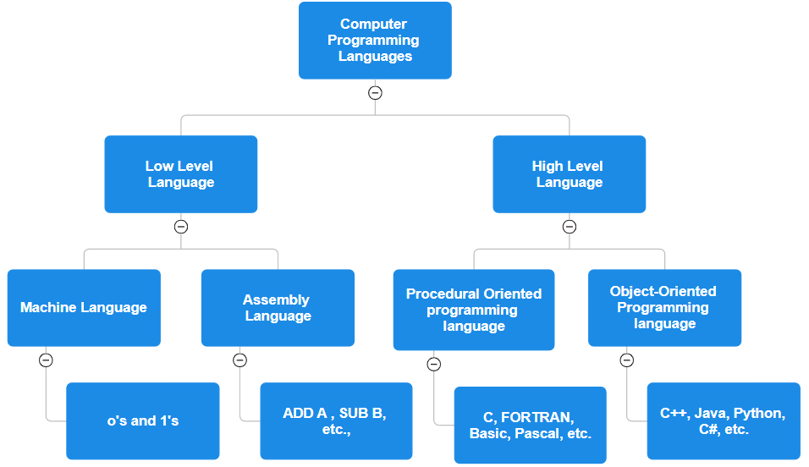
TYPES OF COMPUTER PROGRAMMING LANGUAGES

Slide 8
TYPES OF COMPUTER PROGRAMMING LANGUAGES
1. Low Level Language:-
They are easy to understand by the computer.
But difficult for programmers to read, write and understand.
These are of two types :- a. Machine Language b. Assembly Language
a. Machine Language:-
A Computer can only understand the Machine Language.
Machine Language are written in series of 0's and 1's only. (also known as Binary digits)
It is more difficult to understand and use by the humans.
The processing speed is very fast. Therefore, most of Games and simulation programs are written in machine languages.

Slide 9
TYPES OF COMPUTER PROGRAMMING LANGUAGES
b. Assembly Language:-
Assembly Language is a symbolic programming language.
It uses letter codes instead of binary digits.
These letter codes are alphabetical abbreviation, known as Mnemonics
For example- For Addition, the Mnemonics ADD may be used.
Other examples are For Subtraction, the Mnemonics SUB, For Multiply, the Mnemonics MULT, For Divide, the Mnemonics DIV and so on may be used.

Slide 10
TYPES OF COMPUTER PROGRAMMING LANGUAGES
2. High Level Language:-
These languages are also known as Fourth generation languages.
They are very similar to human languages.
Therefore, they are easy to read, write and understand for programmers.
TYPES:
Procedural Oriented programming language
Object-Oriented Programming language

Slide 11
TYPES OF COMPUTER PROGRAMMING LANGUAGES
Procedural Oriented programming language
Procedural Oriented Programming (POP) language is derived from structured programming and based upon the procedure call concept. It divides a program into small procedures called routines or functions.
Procedural Oriented programming language is used by a software programmer to create a program that can be accomplished by using a programming editor like IDE, Adobe Dreamweaver, or Microsoft Visual Studio.
The advantage of POP language is that it helps programmers to easily track the program flow and code can be reused in different parts of the program.
Example:
C
FORTRAN
Basic
Pascal, etc.

Slide 12
TYPES OF COMPUTER PROGRAMMING LANGUAGES
2. Object-Oriented Programming language
Object-Oriented Programming (OOP) language is based upon the objects. In this programming language, programs are divided into small parts called objects. It is used to implement real-world entities like inheritance, polymorphism, abstraction, etc in the program to makes the program reusable, efficient, and easy-to-use.
The main advantage of object-oriented programming is that OOP is faster and easier to execute, maintain, modify, as well as debug.
Object-Oriented Programming language follows a bottom-up approach.
Example:
C++,
Java
Python
C#, etc.

Slide 13
GENESIS OF C++
C++ was developed by Bjarne Stroustrup at Bell Laboratories over a period starting in 1979.
Since C++ is an attempt to add object-oriented features (plus other improvements) to C, earlier it was called “C with Objects”.
As the language developed, Stroustrup named it C++ in 1983.
It was developed to add a feature of OOP (Object Oriented Programming) in C without significantly changing the C component.
Stroustrup was inspired by the Simula programming language, which was one of the first object-oriented languages. He wanted to create a language that had the same features as Simula, but that was also as efficient as C.
C++ was originally developed as an extension to the C language. It added a number of new features to C, including object-oriented programming, generic programming, and exception handling.
C++ quickly became one of the most popular programming languages in the world. It is used to develop a wide variety of applications, including operating systems, games, and embedded systems.

Slide 14
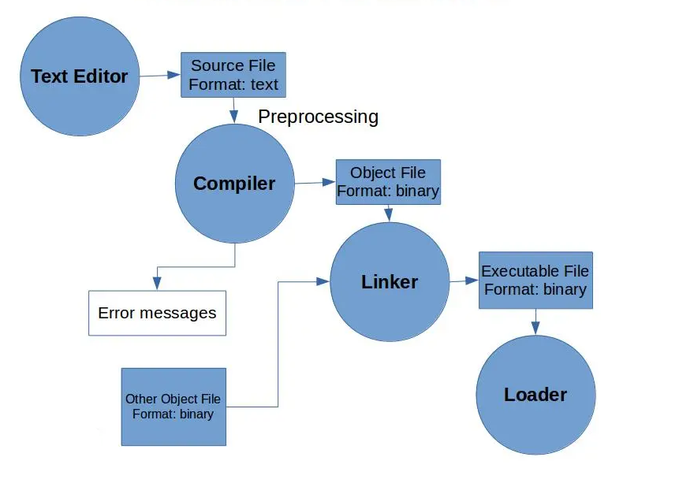
PROGRAM LIFE CYCLE
Every C Program that is in text form goes through a series of transformations to obtain the final executable.
The various Phases of this transformation are as follows:
Preprocessing
Assembling
Compiling
Linking
Loading to main memory

Slide 15
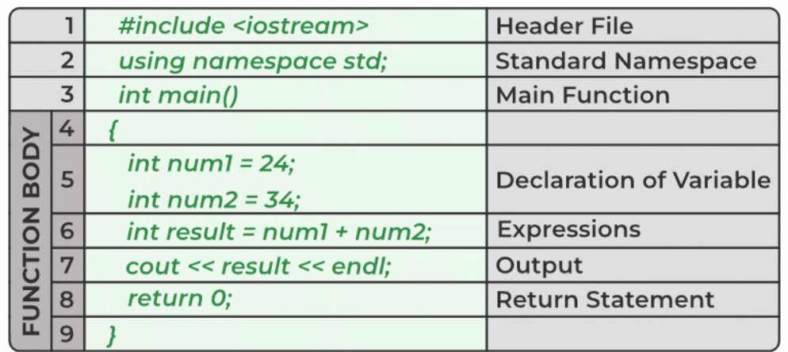
STRUCTURE OF C++ PROGRAM

Slide 16
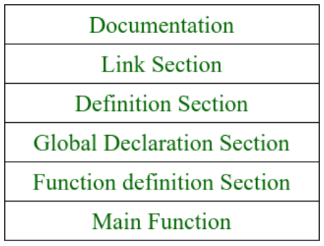
STRUCTURE OF C++ PROGRAM

Slide 17
STRUCTURE OF C++ PROGRAM
1. Documentation Section:
This section comes first and is used to document the logic of the program that the programmer going to code.
It can be also used to write the purpose of the program.
Whatever written in the documentation section is the comment and is not compiled by the compiler.
Documentation Section is optional since the program can execute without them.

Slide 18
STRUCTURE OF C++ PROGRAM
2. Linking Section:
The linking section contains two parts:
a. Header Files:
Generally, a program includes various programming elements like built-in functions, classes, keywords, constants, operators, etc. that are already defined in the standard C++ library.
In order to use such pre-defined elements in a program, an appropriate header must be included in the program.
b. Namespaces:
A namespace permits grouping of various entities like classes, objects, functions, and various C++ tokens, etc. under a single name.
Any user can create separate namespaces of its own and can use them in any other program.
In the below snippets, namespace std contains declarations for cout, cin, endl, etc., statements.
using namespace std;
Namespaces can be accessed in multiple ways:
using namespace std; // cout << “ “ ;
using std :: cout << “ ” ;

Slide 19
STRUCTURE OF C++ PROGRAM
3. Definition Section:
It is used to declare some constants and assign them some value.
In this section, anyone can define your own datatype using primitive data types.
Definition of the function is used for allocating memory for the function.
typedef int INTEGER; this statement tells the compiler that whenever you will encounter INTEGER replace it by int and as you have declared INTEGER as datatype you cannot use it as an identifier.

Slide 20
STRUCTURE OF C++ PROGRAM
4. Global Declaration Section:
Here, the variables and the class definitions which are going to be used in the program are declared to make them global.
The scope of the variable declared in this section lasts until the entire program terminates.
These variables are accessible within the user-defined functions also.
5. Function Declaration Section:
It contains all the functions which our main functions need.
Usually, this section contains the User-defined functions.
This part of the program can be written after the main function but for this, write the function prototype in this section for the function which for you are going to write code after the main function.

Slide 21
STRUCTURE OF C++ PROGRAM
5. Main Function:
The main function tells the compiler where to start the execution of the program. The execution of the program starts with the main function.
All the statements that are to be executed are written in the main function.
The compiler executes all the instructions which are written in the curly braces {} which encloses the body of the main function.
Once all instructions from the main function are executed, control comes out of the main function and the program terminates and no further execution occur.

Slide 22
SIMPLE C++ PROGRAM
#include <iostream>
using namespace std;
int main() {
cout << "Hello!\n";
return 0;
}
OUTPUT:
Hello!

Slide 23
C++ IDENTIFIERS
In C++ programming language, identifiers are the unique names assigned to variables, functions, classes, structs, or other entities within the program. For example, in the below statement,
int num = 11; #num is an identifier.
Rules to Name of an Identifier in C++
We can use any word as an identifier as long as it follows the following rules:
An identifier can consist of letters (A-Z or a-z), digits (0-9), and underscores (_).
Special characters and spaces are not allowed.
An identifier can only begin with a letter or an underscore only.
C++ has reserved keywords that cannot be used as identifiers since they have predefined meanings in the language. For example, int cannot be used as an identifier as it has already some predefined meaning in C++. Attempting to use these as identifiers will result in a compilation error.
Additionally, C++ is a case-sensitive language so the identifier such as Num and num are treated as different.

Slide 24
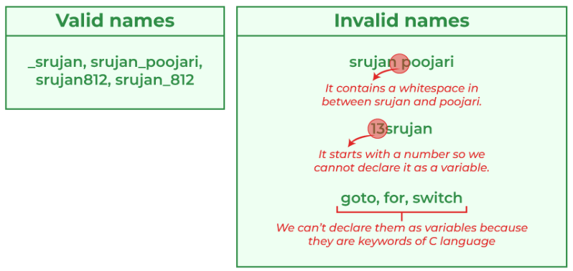
C++ IDENTIFIERS
The below images show some valid and invalid C++ identifiers.

Slide 25
C++ VARIABLES
Variables are containers for storing data values.
Variables are used to give a name to a memory location that holds a value. Hence, a variable is also an identifier.
In structured programming languages such as C, variables must be declared at the starting of the program. In object-oriented programming like C++, variables can be declared anywhere in the program.
According to the scope, there are three types of variables namely, local, global, and reference variables. Variables help to allot a unique name to a specific memory location.

Slide 26
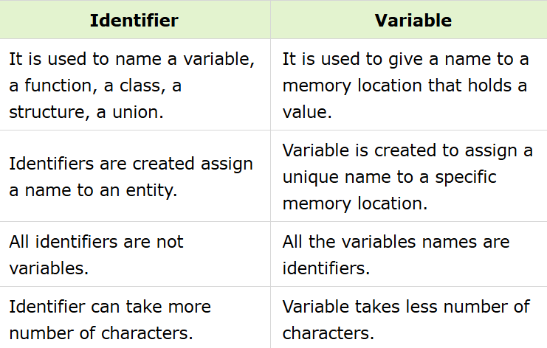
DIFFERENCE BETWEEN IDENTIFIER AND VARIABLE

Slide 27
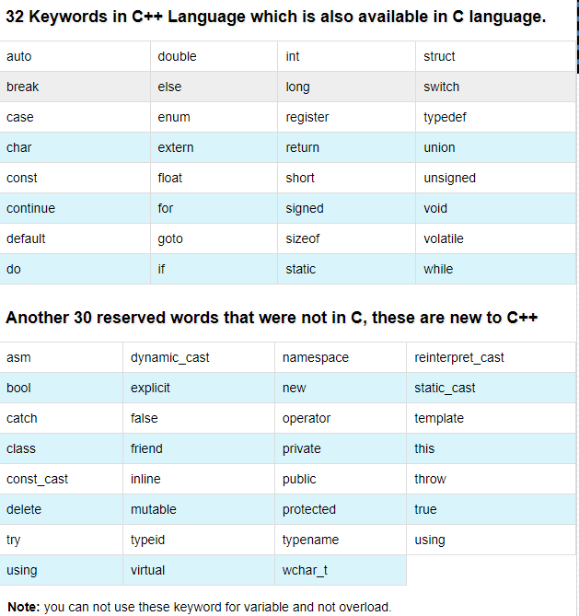
C++ KEYWORDS
Keywords(also known as reserved words) have special meanings to the C++ compiler and are always written or typed in short(lower) cases.
Keywords are words that the language uses for a special purpose, such as void, int, public, etc.
It can’t be used for a variable name or function name or any other identifiers. The total count of reserved keywords is 95.

Slide 28
DATA TYPES IN C++
A data type is the type of data a variable can hold. For example, a Boolean variable can have boolean data, and an integer variable can hold integer data.
While coding, we need to use different variables to store different information.
Variables are just storage locations reserved for storing values. Therefore when you create the variable, you reserve some space in memory.
You may want to store information for different data types, such as integers, floats, strings, and Boolean values.
Memory is allocated based on the variable's data type. The amount of memory required depends on the data type.
int score = 99;
score here is an int datatype variable. The variable score can only store 2-byte or 4-byte integers, depending on the compiler/system.

Slide 29
DATA TYPES IN C++
In C++, data types can be classified as follows:
Primitive / Fundamental Datatypes
Derived Datatypes
User-defined Datatypes

Slide 30
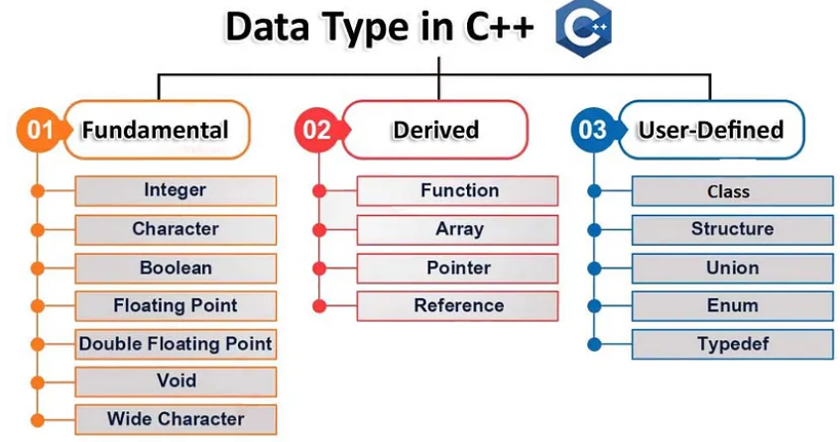
DATA TYPES IN C++

Slide 31
DATA TYPES IN C++
Primitive Data types in C++
Users can use the primitive data types to declare variables, and these are built-in data types in C++, for instance, float, bool, etc. Primitive data types present in C++ are defined below:
1. Integer
The keyword int can represent integer data types. The range of integers is -2147483648 to 2147483647, and they take up 4 bytes of memory.
For example,
int data = 1526;
data here is an integer data type variable. The variable data requires 2 or 4 bytes of memory space.
2. Character
The keyword char represent characters. It is 1 byte in size. Single quotes ' ' are used to enclose characters in C++.
For example,
char ch = 's';
ch here is a character datatype variable. This means that the variable requires 1 byte of memory space.

Slide 32
DATA TYPES IN C++
3. Boolean
The boolean data type's keyword is bool. True or false are the two possible values for the boolean data type. Boolean values are generally used in conditional statements and loops.
For example,
bool is_true = true;
is_true here is a boolean data type variable. This means that the variable requires 1 byte of memory space.
4. Floating Point
float is the keyword used to hold floating-point numbers (decimals and exponentials). The float variable has a size of 4 bytes.
For example,
float val = 15.26;
val here is a floating-point datatype variable. This means that the variable requires 4 bytes of memory space.

Slide 33
DATA TYPES IN C++
5. Double Floating Point
Double is the keyword used to hold floating-point numbers (decimals and exponentials) with double precision. The double variable has a size of 8 bytes.
For example,
double val = 2019.1526;
val here is a double floating-point datatype variable. This means that the variable requires 8 bytes of memory space.
6. Void or Valueless
The term void refers to something that has no worth. The void data type represents a valueless entity. Variables of the void type cannot be declared. It is only used for functions, not returning any data.
7. Wide Character
The wide-character wchar_t data type is similar to the char data type, but its size is 2 or 4 bytes rather than 1 byte. It's used to represent characters that take up more memory than a single char to represent.
For example,
wchar_t w = L'C';
w, here is a wide-character datatype variable that has a value of 67 (L'C') and has a size of 4 bytes. This means that the variable requires 2 bytes or 4 bytes of memory space.

Slide 34
DATA TYPES IN C++
Derived Data types in C++
Derived Data Types are data types that are created by combining primitive or built-in datatypes. There are four different types of derived data types. These are :
1. Function
A function is a code segment or a block of code defined to accomplish a specific purpose.
A function is often designed to spare the user from repeatedly writing the same lines of code for the same input.
All the lines of code are combined into a single function that may be invoked from anywhere. Every C++ application includes a default function called main().
The function also has a return type, which is used to specify the type of data the function would return when its execution is complete.
The function's return type could be any data type, including the void, which states that there is no need to return anything once the execution of that function is complete.
Syntax:
function_return_type function_name (parameters) { }
Example:
int sum(int num1, int num2) { return (num1 + num2); }
Here, the return type of the sum function is an integer, and the function is used to calculate the sum of 2 numbers.

Slide 35
DATA TYPES IN C++
2. Array
An array is a set of elements that are kept in memory in a continuous manner and also have the same type of data present within the array. The purpose of an array is to store a lot of data in a single variable name and sequential order.
Syntax:
datatype array_name[size_of_array];
Example:
int arr[4]={0,1,2,3};
Here, we have defined an integer array of size 4, which can continuously store four integer variables in memory.

Slide 36
DATA TYPES IN C++
3. Pointer
Pointers are symbolic representations of addresses.
Pointers store the addresses of the variables having the same datatype as that of the pointer.
The size of the pointer is either 4 bytes or 8 bytes, no matter what the data type is.
They enable programs to create and change dynamic data structures, as well as to imitate call-by-reference. In C/C++, its generic declaration looks like this:
Syntax:
data_type* variable_name;
Example:
int* point_int;
point_int holds the address of a variable of an integer datatype.

Slide 37
DATA TYPES IN C++
4. Reference
When we declare a variable as a reference, it becomes an alternate name for an existing variable. By adding '&' to a variable's declaration, it can be declared as a reference.
Example:
int val = 1526; int &ref = val;
Here ref becomes the reference to integer val, and now any changes in one would be automatically reflected in the other as they both represent the same memory location.

Slide 38
CONSTANTS IN C++
The const keyword (which stands for constant) is used to specify that the value of a variable cannot be changed anywhere in the program, either intentionally or accidentally. For example,
const double PI = 3.14; // makes PI a constant
Note: The standard naming convention for constants is that they must all be in uppercase letters. For example,
const int MAGIC_NUMBER = 42;

Slide 39
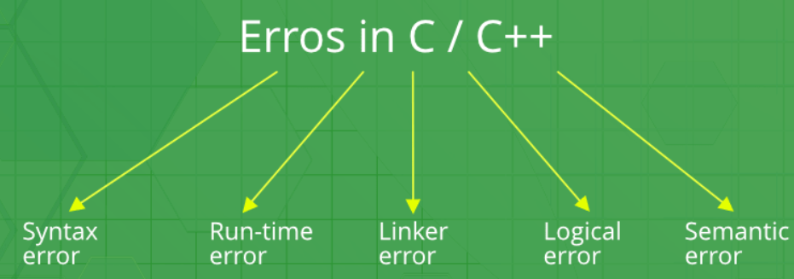
ERRORS IN C++
Error is an illegal operation performed by the user which results in abnormal working of the program.
Programming errors often remain undetected until the program is compiled or executed. Some of the errors inhibit the program from getting compiled or executed. Thus errors should be removed before compiling and executing.
The most common errors can be broadly classified as follows.

Slide 40
ERRORS IN C++
// C++ program to illustrate
// syntax error
#include <iostream>
using namespace std;
void main()
{
int x = 10;
int y = 15;
cout << " "<< (x, y) // semicolon missed
}
error: expected ';' before '}' token
Syntax errors:
Errors that occur when you violate the rules of writing C/C++ syntax are known as syntax errors.
This compiler error indicates something that must be fixed before the code can be compiled.
All these errors are detected by compiler and thus are known as compile-time errors.
Most frequent syntax errors are:
Missing Parenthesis (})
Printing the value of variable without declaring it
Missing semicolon like this:

Slide 41
ERRORS IN C++
// C++ program to illustrate run-time error
#include <iostream>
#include <bits/stdc++.h>
using namespace std;
void main()
{
int n = 9, div = 0;
// wrong logic
// number is divided by 0,
// so this program abnormally terminates
div = n/0;
cout << "result = "<< div;
}
warning: division by zero [-Wdiv-by-zero] div = n/0;
In the given example, there is Division by zero error. This is an example of run-time error i.e errors occurring while running the program.
2. Run-time Errors :
Errors which occur during program execution(run-time) after successful compilation are called run-time errors.
One of the most common run-time error is division by zero also known as Division error.
These types of error are hard to find as the compiler doesn’t point to the line at which the error occurs.

Slide 42
ERRORS IN C++
3. Linker Errors:
These error occurs when after compilation we link the different object files with main’s object using Ctrl+F9 key(RUN).
These are errors generated when the executable of the program cannot be generated.
This may be due to wrong function prototyping, incorrect header files.
One of the most common linker error is writing Main() instead of main().
// C++ program to illustrate
// linker error
#include <bits/stdc++.h>
using namespace std;
void Main() // Here Main() should be main()
{
int a = 10;
cout << " "<< a;
}
(.text+0x20): undefined reference to `main'

Slide 43
ERRORS IN C++
// C++ program to illustrate
// logical error
int main()
{
int i = 0;
// logical error : a semicolon after loop
for(i = 0; i < 3; i++);
{
cout << "loop ";
continue;
}
return 0;
}
No output
4. Logical Errors
On compilation and execution of a program, desired output is not obtained when certain input values are given.
These types of errors which provide incorrect output but appears to be error free are called logical errors.
These are one of the most common errors done by beginners of programming.
These errors solely depend on the logical thinking of the programmer and are easy to detect if we follow the line of execution and determine why the program takes that path of execution.

Slide 44
ERRORS IN C++
// C++ program to illustrate
// semantic error
int main()
{
int a, b, c;
a + b = c; //semantic error
}
error: value required as left operand of assignment a + b = c; //semantic error
5. Semantic errors
This error occurs when the statements written in the program are not meaningful to the compiler.

Slide 45
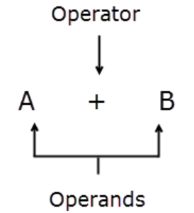
OPERATORS IN C++
An operator is a symbol that operates on a value to perform specific mathematical or logical computations.
They form the foundation of any programming language.
In C++, we have built-in operators to provide the required functionality.
An operator operates the operands. For example,
int c = a + b;
Here, ‘+’ is the addition operator. ‘a’ and ‘b’ are the operands that are being ‘added’.

Slide 46
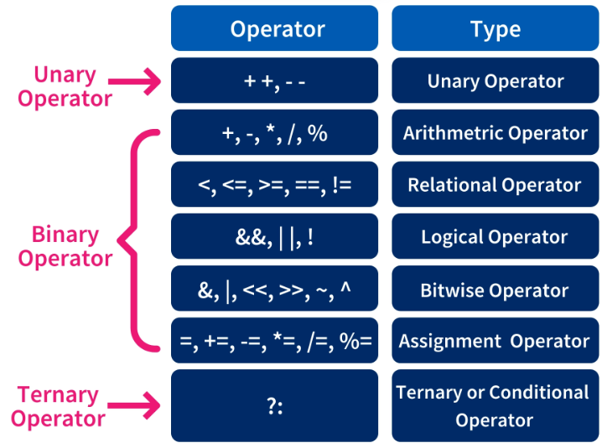
TYPES OF OPERATORS IN C++

Slide 47
TYPES OF OPERATORS IN C++
1) Arithmetic Operators
These operators are used to perform arithmetic or mathematical operations on the operands. For example, ‘+’ is used for addition, ‘-‘ is used for subtraction ‘*’ is used for multiplication, etc.
Arithmetic Operators can be classified into 2 Types:
Unary Operator
Binary Operator

Slide 48
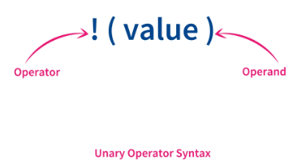
TYPES OF OPERATORS IN C++ - ARITHMETIC
a) Unary Operator
Unary arithmetic operator in C++ is used only with one operand to perform the arithmetic operations.
The increment operators are used to increment the value of a variable by 1, and decrement operators are used to decrement the value of a variable by 1.
Pre-increment or pre-decrement operators first manipulate the value and then get assigned to the variables, whereas post-increment or post-decrement operators first get assigned to the variable, and then the value gets manipulated.

Slide 49
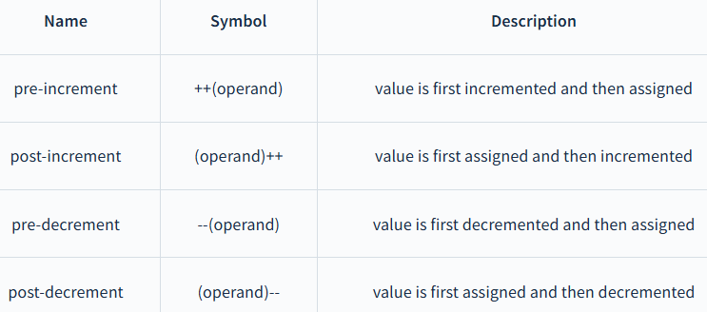
UNARY OPERATOR

Slide 50
UNARY OPERATOR
#include <iostream>
using namespace std;
int main()
{
int x;
int a = 5;
x = a++; // post increment
cout << "value of x is " << x << ", value of a is " << a << endl;
x = ++a; // pre increment
cout << "value of x is " << x << ", value of a is " << a << endl;
x = a--; // post decrement
cout << "value of x is " << x << ", value of a is " << a << endl;
x = --a; // pre decrement
cout << "value of x is " << x << ", value of a is " << a << endl;
return 0;
}
Output:
value of x is 5, value of a is 6
value of x is 7, value of a is 7
value of x is 7, value of a is 6
value of x is 5, value of a is 5

Slide 51
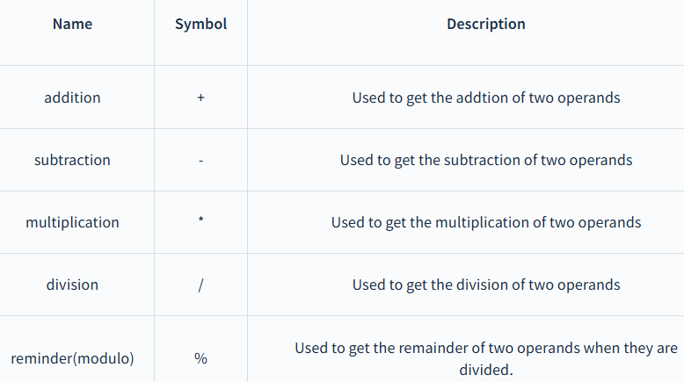
TYPES OF OPERATORS IN C++ - ARITHMETIC
b) Binary Operator
The binary arithmetic operators are the ones that are used with 2 operands to perform the arithmetic operations.

Slide 52
Binary Operator
#include <iostream>
using namespace std;
int main()
{
int a = 8, b = 3;
// Addition operator
cout << "a + b = " << (a + b) << endl;
// Subtraction operator
cout << "a - b = " << (a - b) << endl;
// Multiplication operator
cout << "a * b = " << (a * b) << endl;
// Division operator
cout << "a / b = " << (a / b) << endl;
// Modulo operator
cout << "a % b = " << (a % b) << endl;
return 0;
}
OUTPUT:
a + b = 11
a - b = 5
a * b = 24
a / b = 2
a % b = 2

Slide 53
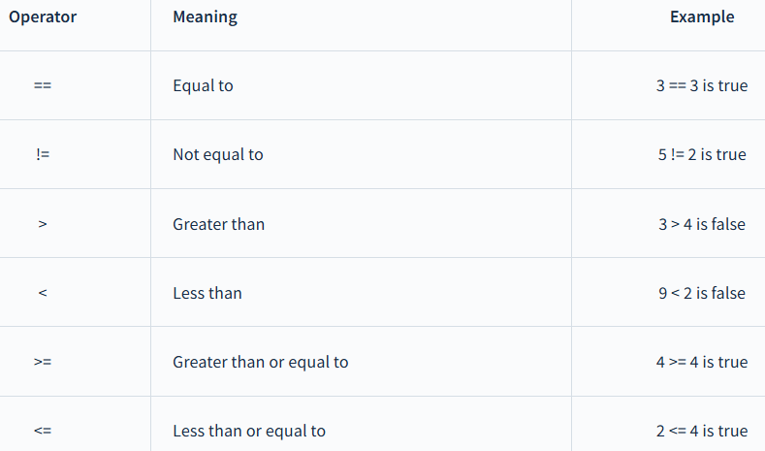
TYPES OF OPERATORS IN C++ - RELATIONAL
2. Relational operators
Relational operators are mainly used to check for specific conditions. These are always binary operators because 2 operands are needed to evaluate the condition. If the condition is true, it will return 1, else if the condition is false, it will return 0.

Slide 54
Relational Operator
#include <iostream>
using namespace std;
int main()
{
int a = 6, b = 4;
cout << "a == b is " << (a == b) << endl; // Equal to operator
cout << "a > b is " << (a > b) << endl; // Greater than operator
cout << "a >= b is " << (a >= b) << endl; // Greater than or Equal to operator
cout << "a < b is " << (a < b) << endl; // Lesser than operator
cout << "a <= b is " << (a <= b) << endl; // Lesser than or Equal to operator
cout << "a != b is " << (a != b) << endl; // true
return 0;
}
Output:
a == b is 0
a > b is 1
a >= b is 1
a < b is 0
a <= b is 0
a != b is 1
Here, 0 denotes false and 1 denotes true

Slide 55
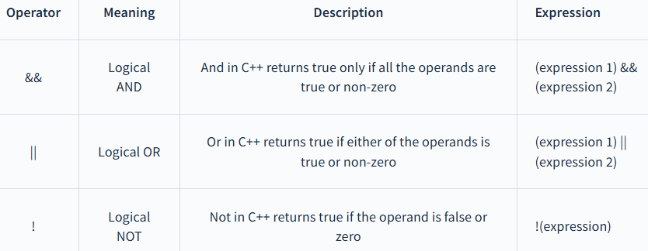
OPERATORS IN C++ - LOGICAL OPERATORS
3. Logical operators
Logical operators are used to check logical conditions.
They return the 1 when the result is true and 0 when the result is false.
There are three logical operators in C++:
1. And operator
2. Or operator
3. Not operator

Slide 56
Logical operators
#include <iostream>
using namespace std;
int main()
{
int a = 6, b = 4;
// Logical AND operator
cout << "a && b is " << (a && b) << endl;
// Logical OR operator
cout << "a || b is " << (a || b) << endl;
// Logical NOT operator
cout << "!b is " << (!b) << endl;
return 0;
}
Output:
a && b is 1
a ! b is 1
!b is 0

Slide 57
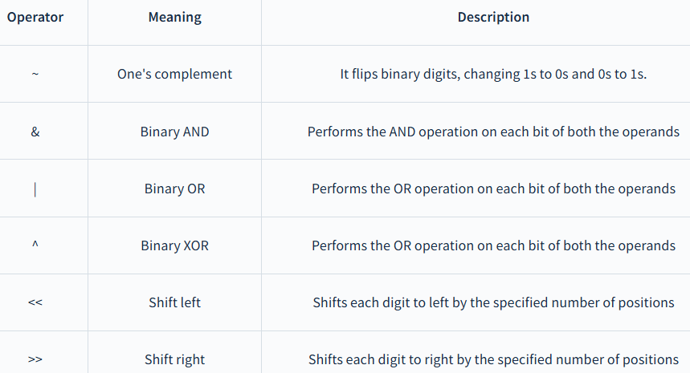
OPERATORS IN C++ - BITWISE OPERATORS
4. Bitwise operators
Bitwise operators are fundamental to systems programming, enabling manipulation of data at the bit level, which can lead to more efficient code. These operators are used to perform operations on binary representations of numbers, where the operations are carried out bit by bit.

Slide 58
BITWISE OPERATORS
These operations are performed on the bits of the data not on the whole data as on a single unit but on the bits of the data. Bitwise operators operate on bits and it performs a bit-by-bit operation. The Bitwise operators in C++ are as follows.
Bitwise And &
Bitwise OR |
Bitwise X-OR ^
Bitwise Not ~
Binary Leftshift <<
Binary Rightshift >>

Slide 59
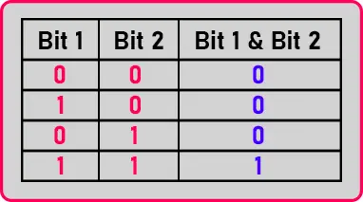
BITWISE OPERATORS
Bitwise AND:
Suppose if there are two bits, bit 1 and bit 2, Two-Bits are there then:
If bit 1 and bit 2 both are 0 then bit 1 & bit 2 will also be 0.
If bit 1 is 1 and bit 2 is 0 then bit 1 & bit 2 will be 0.
If bit 1 is 0 and bit 2 is 1 then bit 1 & bit 2 will be 0.
If bit 1 and bit 2 both are 1 then only bit 1 & bit 2 will be 1.

Slide 60
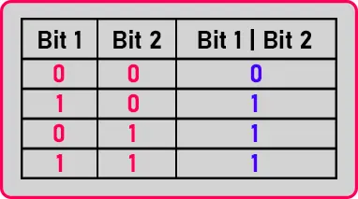
BITWISE OPERATORS
Bitwise OR:
Here we can see in the table that Bit 1 | Bit 2 will be 1 if any one of the bits is 1. And Bit 1 | Bit 2 will be 0 if both the bits are 0.

Slide 61
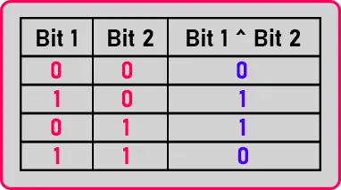
BITWISE OPERATORS
Bitwise XOR (Exclusively-OR)
Then, if both the bits are different then only Bit 1 ^ Bit 2 will be 1. If Bit 1 and Bit 2 are the same then Bit 1 ^ Bit 2 will be 0.
The other bit must be 0 or if one bit is 0 then the other bit must be 1 then only Bit 1 ^ Bit 2 will be 1.

Slide 62
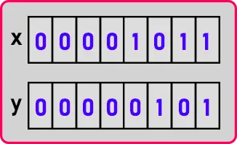
BITWISE OPERATORS
Let us learn all these operations by using examples.
int x = 11, y = 5, z;
We have an integer variable ‘x’ of value 11, another variable ‘y’ of value 5, and ‘z’. We know that these numbers are actually stored in binary form. So, the value of ‘x’ and ‘y’ in the binary form will be:
We have assumed that int takes 2 bytes means 16 bits but here we have shown only 8 bits as all remaining bits are ‘0’.

Slide 63
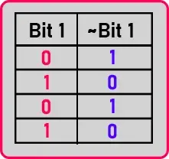
BITWISE OPERATORS
Bitwise NOT (Compliment):
NOT is a unary operation that means an operation with only one operand. In this operation,
Here you can see that the NOT inverts the bits of its operant. If the bit is 1 then NOT will be 0 and if the bit is 0 then NOT will be 1.

Slide 64
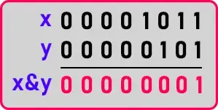
BITWISE OPERATORS
Bitwise AND Example:
Now If I use AND operation and store the result in variable ‘z’ then,
int x = 11, y = 5, z;
z = x & y;
So, the bits of ‘x’ and ‘y’ will be AND. Above we see the truth table and according to that we will apply AND between x and y as:
The result of x&y will be ‘0 0 0 0 0 0 0 1’. It is ‘1’ in decimal form so ‘1’ will be stored in the ‘z’ variable. So, in this way, we performed Bitwise AND operation.

Slide 65
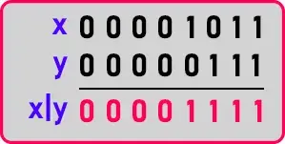
BITWISE OPERATORS
Bitwise OR Example:
Let us see what will be the result of OR operation.
int x = 11, y = 7, z;
Here we have taken ‘x’ as 11, ‘y’ as 7, and z uninitialized. Now we will use show you OR operation between x and y:
Here the result will be one if either of any bit is 1. The result of x|y is ‘0 0 0 0 1 1 1 1’. It is 15 in decimal form and this 15 will be stored in the ‘z’ variable. It is not like addition or subtraction that we directly look at the value and give the answer. Unless we perform some bitwise operations, we cannot get the answer. So, if you have some practice on this then you may be able to get it. In this way, we have performed a Bitwise OR operation.

Slide 66
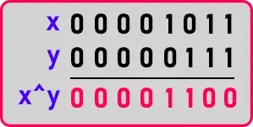
BITWISE OPERATORS
Bitwise XOR Example
Now let us see XOR Operation,
int x = 11, y = 7, z;
Here also we have taken the same example as the previous one. Let us perform XOR between x and y:
In this operation, the result will be 1 if both the bits are different i.e. 0 or 1, 1 or 0. So, the result of x^y is ’0 0 0 0 1 1 0 0’. It is 12 in decimal form.

Slide 67
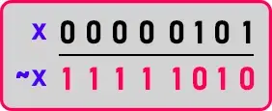
BITWISE OPERATORS
Bitwise NOT Example:
Let us look at NOT:
char x = 5, y;
y = ~x;
We have taken 2 variables ‘x’ with the value of 5 and ‘y’ uninitialized. Then we store ~x in the y variable,
Here we know the 1st bit is the sign bit. Now it is 1, which means the number will be negative. So, the result of ‘~x’ is ‘1 1 1 1 1 0 1 0’. For decimal form, we have to convert it into 2’s complement as it is a negative number. So, first, we have to convert 1 to 0 and 0 to 1:

Slide 68
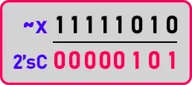
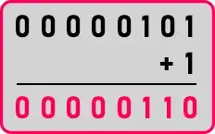
BITWISE OPERATORS
We reversed the bit, now we have to add 1:
Now it is ‘0 0 0 0 0 1 1 0’. It is 6 in decimal form. But as we have sign bit on in ‘~x’ so it will be -6.

Slide 69
BITWISE OPERATORS
Where do we need NOT operation?
If you are developing a device driver, or if we are developing code for system programs or system applications or tools then there you may be working closer to electronics and these are the operations in electronics.
Your logic itself is defined in terms of bit operations so then you can use this operator for writing your procedures.
So, if you are writing hardware-based or device-based drivers then it is useful.
Now let us show the left shift and right shift.

Slide 70
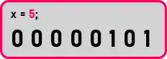
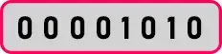
BITWISE OPERATORS
Left Shift and Right Shift:
int x = 5, y;
y = x << 1;
We want to store the result of the left shift of x by 1 in the y variable. We know the value of x is 5, then in binary will be:
In the Left shift, we have to shift all the bits to the left-hand side by the value given by the user. In this case, we will shift all the bits by one to the left-hand side as:

Slide 71
BITWISE OPERATORS
When we shift all the bits then the last place will be vacant.
So, insert 0 there. Now, this is ‘000001010’ and this is 10 in decimal form.
One more important thing is that if we write x << i. (i is some number here then x will be multiplied with 2^{i}.
In the right shift, all the bits will be shifted towards the right and the vacant spaces will be filled by ‘0’.

Slide 72

BITWISE OPERATORS
We will perform x >> 1 as:
If we write x >> i (i is some number here) then x will be divided by 2^{i}. Now it will be 2 in decimal form. Let’s see these all operations in code.
Note: Binary left shift shifts the bits to the left side as the number of times you specified. Mainly it will do multiplication. Binary RightShift shifts the bits to the Right side as the number of times you specified. Mainly it will do division.

Slide 73
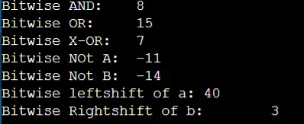
BITWISE OPERATORS
#include <iostream>
using namespace std;
int main ()
{
int a = 10, b = 13;
cout << "Bitwise AND: \t" << (a & b) << endl;
cout << "Bitwise OR: \t" << (a | b) << endl;
cout << "Bitwise X-OR: \t" << (a ^ b) << endl;
cout << "Bitwise NOt A: \t" << ~a << endl;
cout << "Bitwise Not B: \t" << ~b << endl;
a = a << 2;
cout << "Bitwise leftshift of a:\t" << a << endl;
b = b >> 2;
cout << "Bitwise Rightshift of b:\t" << b << endl;
return 0;
}
OUTPUT

Slide 74
OPERATORS IN C++ - ASSIGNMENT OPERATORS
Assignment Operators
These operators are used to assign value to a variable. For example: num = 6 will assign the value 6 to the variable num.
The left side operand of the assignment operator is a variable and the right side operand of the assignment operator is a value.
The value on the right side must be of the same data type as the variable on the left side otherwise the compiler will raise an error.

Slide 75
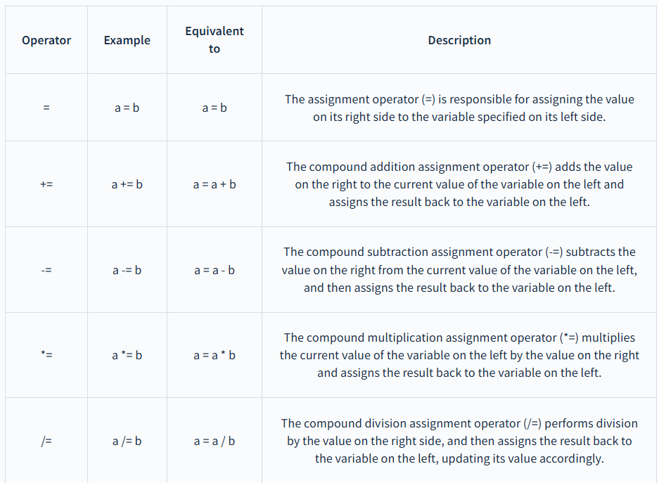
OPERATORS IN C++ - ASSIGNMENT OPERATORS

Slide 76
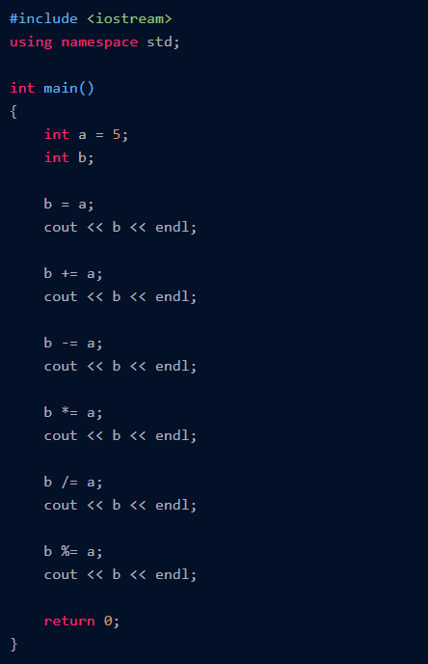
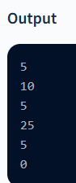
OPERATORS IN C++ - ASSIGNMENT OPERATORS

Slide 77
OPERATORS IN C++ - TERNARY/CONDITIONAL
The ternary operator in C++, often denoted as "? :", is a concise way to express conditional logic in many programming languages. It takes three operands:
Expression1? Expression2: Expression3
Here's how it works:
The condition (Expression1) is evaluated first.
If the condition is true, the value of Expression2 is returned.
If the condition is false, the value of Expression3 is returned.

Slide 78
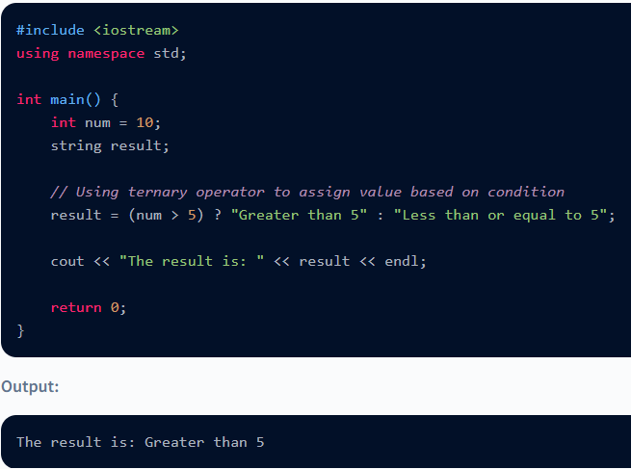
OPERATORS IN C++ - TERNARY/CONDITIONAL

Slide 79
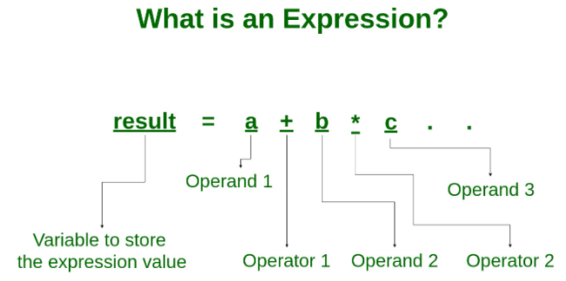
EXPRESSION IN C++
An expression is a combination of operators, constants and variables. An expression may consist of one or more operands, and zero or more operators to produce a value.
Example:
a+b
c
s-1/7*f

Slide 80
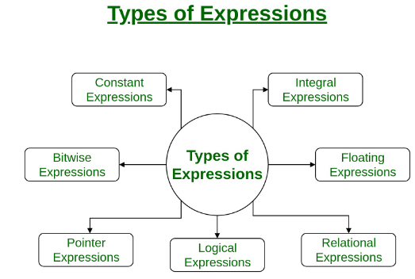
TYPES OF EXPRESSIONS

Slide 81
TYPES OF EXPRESSIONS
1. Constant expressions: Constant Expressions consists of only constant values. A constant value is one that doesn’t change.
Examples:
5, 10 + 5 / 6.0, ‘x’
2. Integral expressions: Integral Expressions are those which produce integer results after implementing all the automatic and explicit type conversions.
Examples:
x, x * y, x + int( 5.0)
where x and y are integer variables.

Slide 82
TYPES OF EXPRESSIONS
3. Floating expressions: Float Expressions are which produce floating point results after implementing all the automatic and explicit type conversions.
Examples:
x + y, 10.75
where x and y are floating point variables.
4. Relational expressions: Relational Expressions yield results of type bool which takes a value true or false. When arithmetic expressions are used on either side of a relational operator, they will be evaluated first and then the results compared. Relational expressions are also known as Boolean expressions.
Examples:
x <= y, x + y > 2

Slide 83
TYPES OF EXPRESSIONS
5. Logical expressions: Logical Expressions combine two or more relational expressions and produces bool type results.
Examples:
x > y && x == 10, x == 10 || y == 5
6. Pointer expressions: Pointer Expressions produce address values.
Examples:
&x, ptr, ptr++
where x is a variable and ptr is a pointer.
7.Bitwise expressions: Bitwise Expressions are used to manipulate data at bit level. They are basically used for testing or shifting bits.
Examples:
x << 3
shifts three bit position to left
y >> 1
shifts one bit position to right.
Shift operators are often used for multiplication and division by powers of two.

Slide 84
TYPE CONVERSIONS
A type cast is basically a conversion from one type to another. There are two types of type conversion:
Implicit Type Conversion
Explicit Type Conversion

Slide 85
IMPLICIT TYPE CONVERSION
Also known as ‘automatic type conversion’.
Done by the compiler on its own, without any external trigger from the user.
Generally takes place when in an expression more than one data type is present. In such condition type conversion (type promotion) takes place to avoid lose of data.
All the data types of the variables are upgraded to the data type of the variable with largest data type.
bool -> char -> short int -> int ->
unsigned int -> long -> unsigned ->
long long -> float -> double -> long double

Slide 86
EXAMPLE OF TYPE IMPLICIT CONVERSION
#include <iostream>
using namespace std;
int main()
{
int x = 10; // integer x
char y = 'a'; // character c
// y implicitly converted to int. ASCII
// value of 'a' is 97
x = x + y;
// x is implicitly converted to float
float z = x + 1.0;
cout << "x = " << x << endl
<< "y = " << y << endl
<< "z = " << z << endl;
return 0;
}
OUTPUT:
x = 107
y = a
z = 108

Slide 87
EXPLICIT TYPE CONVERSION
This process is also called type casting and it is user-defined. Here the user can typecast the result to make it of a particular data type.
In C++, it can be done by two ways:
Converting by assignment: This is done by explicitly defining the required type in front of the expression in parenthesis. This can be also considered as forceful casting.
Syntax:
(type) expression
where type indicates the data type to which the final result is converted.

Slide 88
EXAMPLE OF TYPE EXPLICIT CONVERSION
#include <iostream>
using namespace std;
int main()
{
double x = 1.2;
// Explicit conversion from double to int
int sum = (int)x + 1;
cout << "Sum = " << sum;
return 0;
}
OUTPUT:
Sum = 2

Slide 89
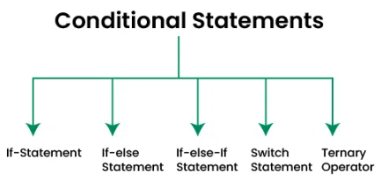
CONTROL-FLOW STATEMENTS - CONDITIONAL STATEMENTS
Conditional statements in programming are used to control the flow of a program based on certain conditions.
These statements allow the execution of different code blocks depending on whether a specified condition evaluates to true or false, providing a fundamental mechanism for decision-making in algorithms.

Slide 90
IF CONDITIONAL STATEMENT
The if statement is the most basic form of conditional statement. It checks if a condition is true. If it is, the program executes a block of code.
Syntax of If Conditional Statement:
if (condition)
{
// code to execute if condition is true
}
if condition is true, the if code block executes. If false, the execution moves to the next block to check.

Slide 91
IF CONDITIONAL STATEMENT
#include <bits/stdc++.h>
using namespace std;
int main()
{
int x = 10;
if (x > 0) {
cout<<"x is positive";
}
return 0;
}
OUTPUT:
x is positive

Slide 92
IF-ELSE CONDITIONAL STATEMENT
The if-else statement extends the if statement by adding an else clause. If the condition is false, the program executes the code in the else block.
Syntax of If-Else Conditional Statement
if (condition)
{
// code to execute if condition is true
} else {
// code to execute if condition is false
}
if condition is true, the if code block executes. If false, the execution moves to the else block.

Slide 93
IF-ELSE CONDITIONAL STATEMENT
#include <bits/stdc++.h>
using namespace std;
int main()
{
int x = -10;
if (x > 0) {
cout << "x is positive";
}
else {
cout << "x is not positive";
}
return 0;
}

Slide 94
IF-ELSE IF CONDITIONAL STATEMENT
The if-else if statement allows for multiple conditions to be checked in sequence. If the if condition is false, the program checks the next else if condition, and so on.
Syntax of If-Else if Conditional Statement:
if (condition1) {
// code to execute if condition1 is true
} else if (condition2) {
// code to execute if condition2 is true
} else {
// code to execute if all conditions are false
}
In else if statements, the conditions are checked from the top-down, if the first block returns true, the second and the third blocks will not be checked, but if the first if block returns false, the second block will be checked. This checking continues until a block returns a true outcome.

Slide 95
IF-ELSE IF CONDITIONAL STATEMENT
#include <bits/stdc++.h>
using namespace std;
int main()
{
int x = 0;
if (x > 0) {
cout << "x is positive";
}
else if (x < 0) {
cout << "x is not positive";
}
else {
cout << "x is not zero";
}
return 0;
}
OUTPUT:
x is not zero

Slide 96
SWITCH CONDITIONAL STATEMENT
The switch statement is used when you need to check a variable against a series of values. It’s often used as a more readable alternative to a long if-else if chain.
In switch expressions, each block is terminated by a break keyword. The statements in switch are expressed with cases.
switch (variable) {
case value1:
// code to execute if variable equals value1
break;
case value2:
// code to execute if variable equals value2
break;
default:
// code to execute if variable doesn't match any value
}

Slide 97
SWITCH CONDITIONAL STATEMENT
#include <iostream>;
using namespace std;
int main()
{
int x = 2;
switch (x) {
case 1:
cout << "x is one";
break;
case 2:
cout << "x is two";
break;
default:
cout << "x is neither one nor two";
}
return 0;
}
OUTPUT:
x is two

Slide 98
TERNARY EXPRESSION CONDITIONAL STATEMENT
The ternary operator is a shorthand way of writing an if-else statement. It takes three operands: a condition, a result for when the condition is true, and a result for when the condition is false.
Syntax of Ternary Expression:
condition ? result_if_true : result_if_false

Slide 99
TERNARY EXPRESSION CONDITIONAL STATEMENT
#include <iostream>;
using namespace std;
int main()
{
int x = 10;
string result
= (x > 0) ? "x is positive" : "x is not positive";
cout << result;
return 0;
}
OUTPUT:
x is positive

